Slide 1
Ecom America

Slide 2
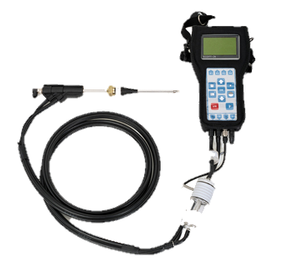
ECOM CN

Slide 3
ECOM Analyzer Features
Electrochemical Sensors - City Technology Sensors designed specifically for emissions applications.
Internal Vacuum Pump - Strong, High quality, pumps for fast response and industrial applications.
Sample Line & Probe – Teflon lined, high temperature sample lines & Inconel probes
Filter for Particulates & Water – Efficient, easy to change filters to protect the analyzer & sensors.
LCD Display – High quality, easy to read display
Printer – Impact printers / standard paper
DAS Software – Designed for Compliance Testing

Slide 4
Electrochemical Sensors
A small capillary allows gas to diffuse into the sensor at controlled rate
A chemical reaction occurs:
oxidation or reduction
The chemical reaction generates a current.
This current is directly proportional to the concentration of the gas.
Notes:
Electrochemical sensors are designed to measure a cool, relatively dry, flow and pressure controlled sample of gas. The electrochemical sensor combines several small electrodes, specifically positioned in an acidic hydrous solution, all sealed in a small, round housing, with tiny gold pins protruding from the bottom side. On the topside, a small round filter material covers a tiny capillary. It is through this capillary which the specific gas to be measured passes and enters the acid solution. At this point a chemical reaction takes place, generating a small electrical current. The internal electrodes, connected to the gold pins mentioned above, transmit this signal to the analyzer electronics. The analyzer then displays a value of the gas proportional to the signal generated.

Slide 5
The Advantages of Ecom
Flow & Pressure Control – ECOM uses a specially designed sensor manifold that delivers very precise flow and pressure to each sensor.
High flow pump – ECOM also uses high flow pumps, which delivers proper flow through the gas cooler & water trap assembly, maximizing the efficiency of the moisture removal system.

Slide 6
Analyzer Workshop / Walk through

Slide 7
Basic Emission Testing Procedure
1. Start the analyzer in fresh air.
2. Allow analyzer to run for 15-30 minutes to reach stable temperature.
3. Turn analyzer off and re-power. The analyzer will set accurate zero reference points & temperature compensation curves for the current temperature.
4. Insert probe into gas stream and observe the readings on the
display.
5. Upon completion of sampling, pull sample line out and allow analyzer to purge with fresh air until O2 readings are above 20.0% and other readings are below 15 ppm before powering off.

Slide 8
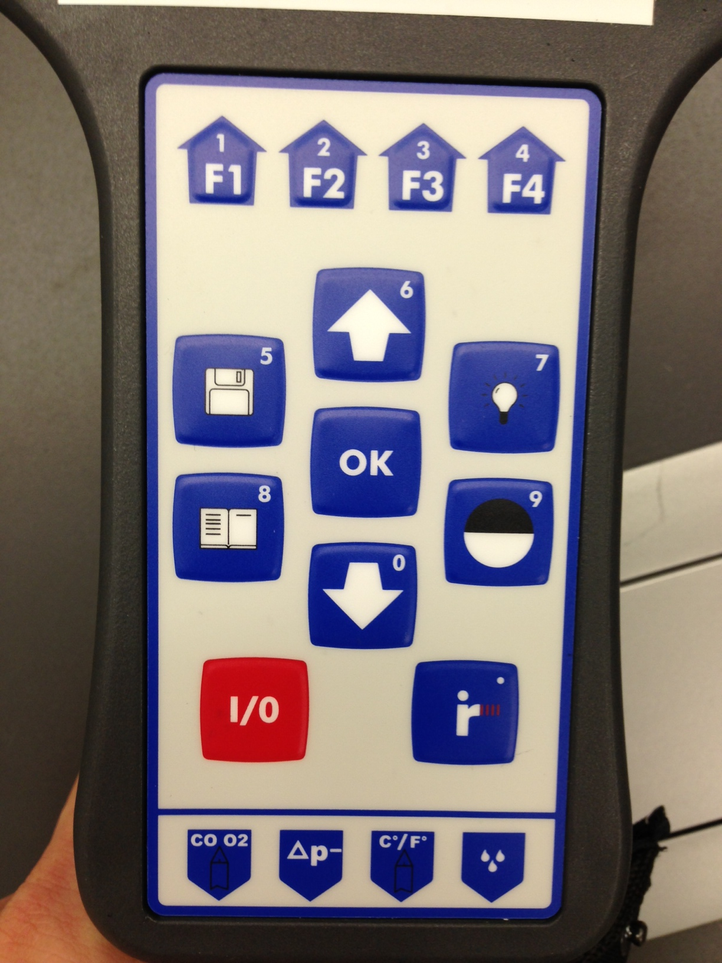
keypad

Slide 9
Combustion meas. - choose fuel type
Once you enter Combustion Measurement, the pump will turn on.
First you must select your fuel. Press up/down to scroll between the fuel type selections.
The Fuel Type selection only affects the CO2, Efficiency, and Losses calculations NOT the ppm concentration of the emissions.

Slide 10
1-minute auto zero
The 1-minute auto zero sequence does the following:
-Calibrates O2 sensor at 20.9%
-Sets zero points for all other sensors
-Sets temperature compensation curves for current temperature
-Checks mV reading of all sensors i.e. “function test”
Note: If the ambient temperature drifts more than 10°F, it is recommended to restart the analyzer to set accurate temperature compensation.

Slide 11
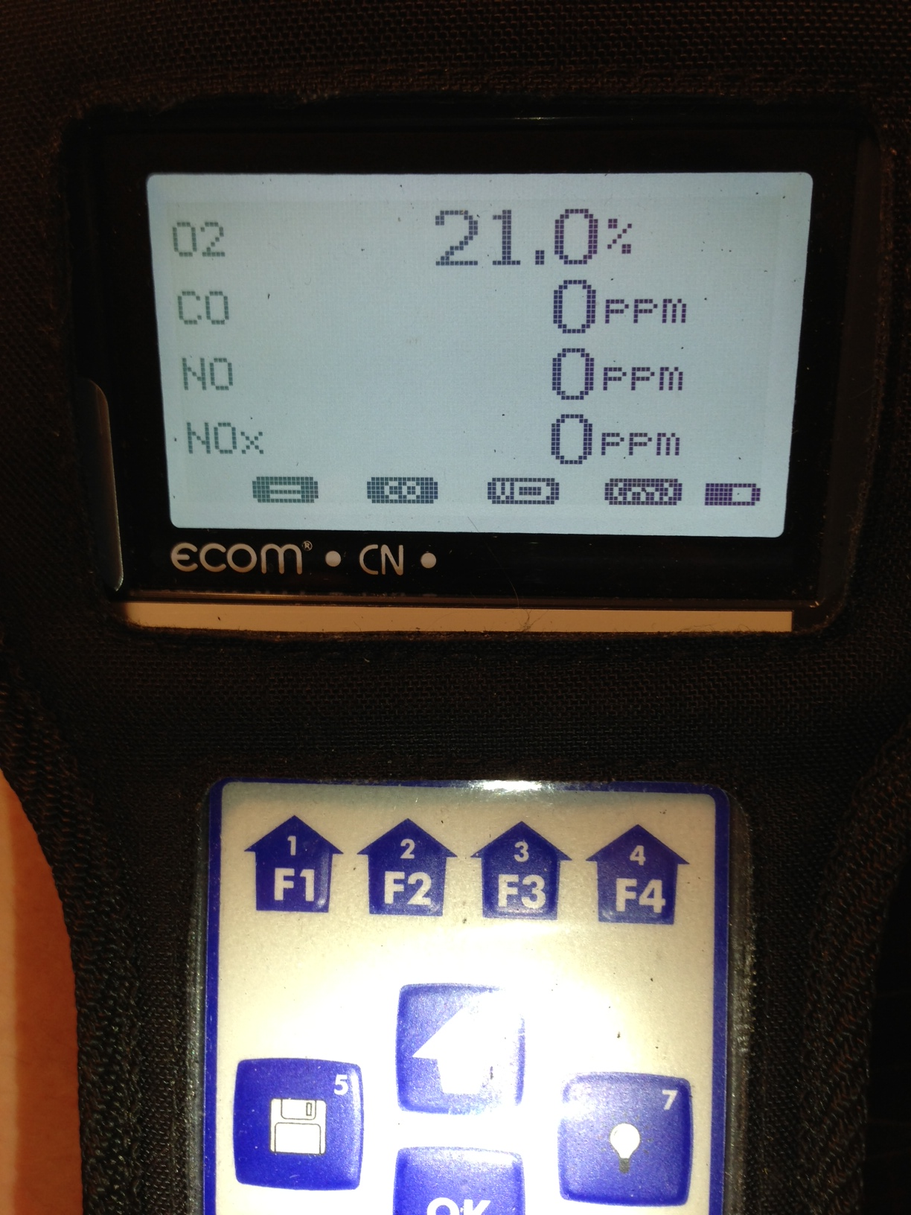
Combustion meas.
After the 1-minute auto-zero sequence, you will enter Combustion Measurement mode.
There are 3 display screens:
Press up/down to toggle between 3 display screens
1: Zoom display 1(4 lines – large font size)
2: Zoom display 2 (4 lines – large font size)
3: Full display (8 lines)
There are 4 icons at the bottom of the display:
F1: Edit display lines
F2: CO purge pump on/off
F3: Show battery life
F4: Show memory file (shuts off pump)

Slide 12
CO purge pump
An automatic CO purge pump introduces fresh air into the CO sensor when CO concentrations exceed pre-set limits of the sensor (usually 4000ppm).
This protects the CO sensor from over-range damage.
The analyzer will monitor the CO level and turn the pump off when levels drop below the maximum range of the sensors.
Pressing F2 while in Combust. Meas. mode activates the CO purge pump manually. The CO will dash out on the screen. Press F2 again to turn off the purge pump.

Slide 13
Adjustments
Adjustments allows the user to make changes to calculated and measured values, such as:
Units (ppm, mg/m3)
O2 Correction
Time / Date Set
Baud rates
Key beep

Slide 14
Units of Measure
Units of measure can be
selected for :
PPM
PPM – O2 Corrected
Mg/m3
Mg/m3 – O2 corrected
(undiluted = O2 corrected)

Slide 15
General Care & Maintenance

Slide 16
filters
The CN has 3 filters which should be periodically changed:
Particulate filter (top of water trap)
In-line smoke filter (tubing leading out of water trap)
Condensate filter (inside water trap bowl)

Slide 17
filters
In-line smoke filter
Particulate filter
Expandable condensate filter

Slide 18
Filters – particulate filter & in-line smoke filter
Particulate filter
First line of defense
Filters out particulates and NH3
Change when it turns dark gray
In-line smoke filter
Second line of defense
Filters out microparticulates & smoke
Change when it turns dark gray

Slide 19
Storing the analyzer
Keep the battery fully charged and operate the analyzer on AC main voltage when possible.
Fully charge the battery prior to storage or leave connected to main power if possible. Full charge takes 8-10 hours.
Store the analyzer in a cool, dry place while plugged into AC power. If it is not possible to keep the analyzer plugged in while stored, make sure to charge it overnight at least once/month.

Slide 20
Basic Emission Testing Procedure
1. Start the analyzer in fresh air.
2. Allow analyzer to run for 15-30 minutes to reach stable temperature.
3. Turn analyzer off and re-power. The analyzer will set accurate zero reference points & temperature compensation curves for the current temperature.
4. Insert probe into gas stream and observe the readings on the
display.
5. Upon completion of sampling, pull sample line out and allow analyzer to purge with fresh air until O2 readings are above 20.0% and other readings are below 15 ppm before powering off.

Slide 21
Thank you
1628 Oakbrook Drive
Gainesville, GA 30507
Toll Free: 877.326.6411
Telephone: 770.532.3280
Fax: 770.532.3620
www.ecomusa.com

