Slide 1
Ecom America
J2KN Pro Training

Slide 2
ECOM America Ltd.
Established in USA in 1993
Sister company of RBR-ECOM, located in Iserlohn, Germany, established in 1985
Manufacturer of high quality portable combustion / emission analyzers

Slide 3
ECOM Analyzer Features
Electrochemical Sensors - City Technology Sensors designed specifically for emissions applications.
Internal Vacuum Pump - Strong, High quality, pumps for fast response and industrial applications.
Sample Line & Probe – Teflon lined, high temperature sample lines & Inconel probes
Filter for Particulates & Water – Efficient, easy to change filters to protect the analyzer & sensors.
LCD Display – High quality, easy to read display
Printer – Impact printers / standard paper

Slide 4
Electrochemical Sensors
A small capillary allows gas to diffuse into the sensor at controlled rate
A chemical reaction occurs:
oxidation or reduction
The chemical reaction generates a current.
This current is directly proportional to the concentration of the gas.
Notes:
Electrochemical sensors are designed to measure a cool, relatively dry, flow and pressure controlled sample of gas. The electrochemical sensor combines several small electrodes, specifically positioned in an acidic hydrous solution, all sealed in a small, round housing, with tiny gold pins protruding from the bottom side. On the topside, a small round filter material covers a tiny capillary. It is through this capillary which the specific gas to be measured passes and enters the acid solution. At this point a chemical reaction takes place, generating a small electrical current. The internal electrodes, connected to the gold pins mentioned above, transmit this signal to the analyzer electronics. The analyzer then displays a value of the gas proportional to the signal generated.

Slide 5
Gas Cooler & Moisture Removal
The Advantages of Ecom
Notes:
We explain to our customers the importance of proper gas cooling and ,moisture removal. And also show them how it works.

Slide 6
ECOM vs. Competition
Portable analyzers is all we do
Rugged packaging, robust analyzer
High strength internal pump = fast response time, consistency of results
ECOM analyzers are known for having advanced sample conditioning features
1-2 week turn-around when you send in your analyzer in for service

Slide 7
ECOM vs. Competition
Inadequate Sample Conditioning – gas coolers are generally too small to effectively cool the gas and remove the moisture.
Pump Flow Rate too low – ECOM uses a 2–3 liter per minute flow. Competitors use 0.5-1.5 liter per minute. This means:
Slow response time
Slow stabilization
Limits the use of a longer sample line
Allows gas to be in contact with moisture for longer period of time
NO2 drop-out leads to lower NOx accuracy

Slide 8
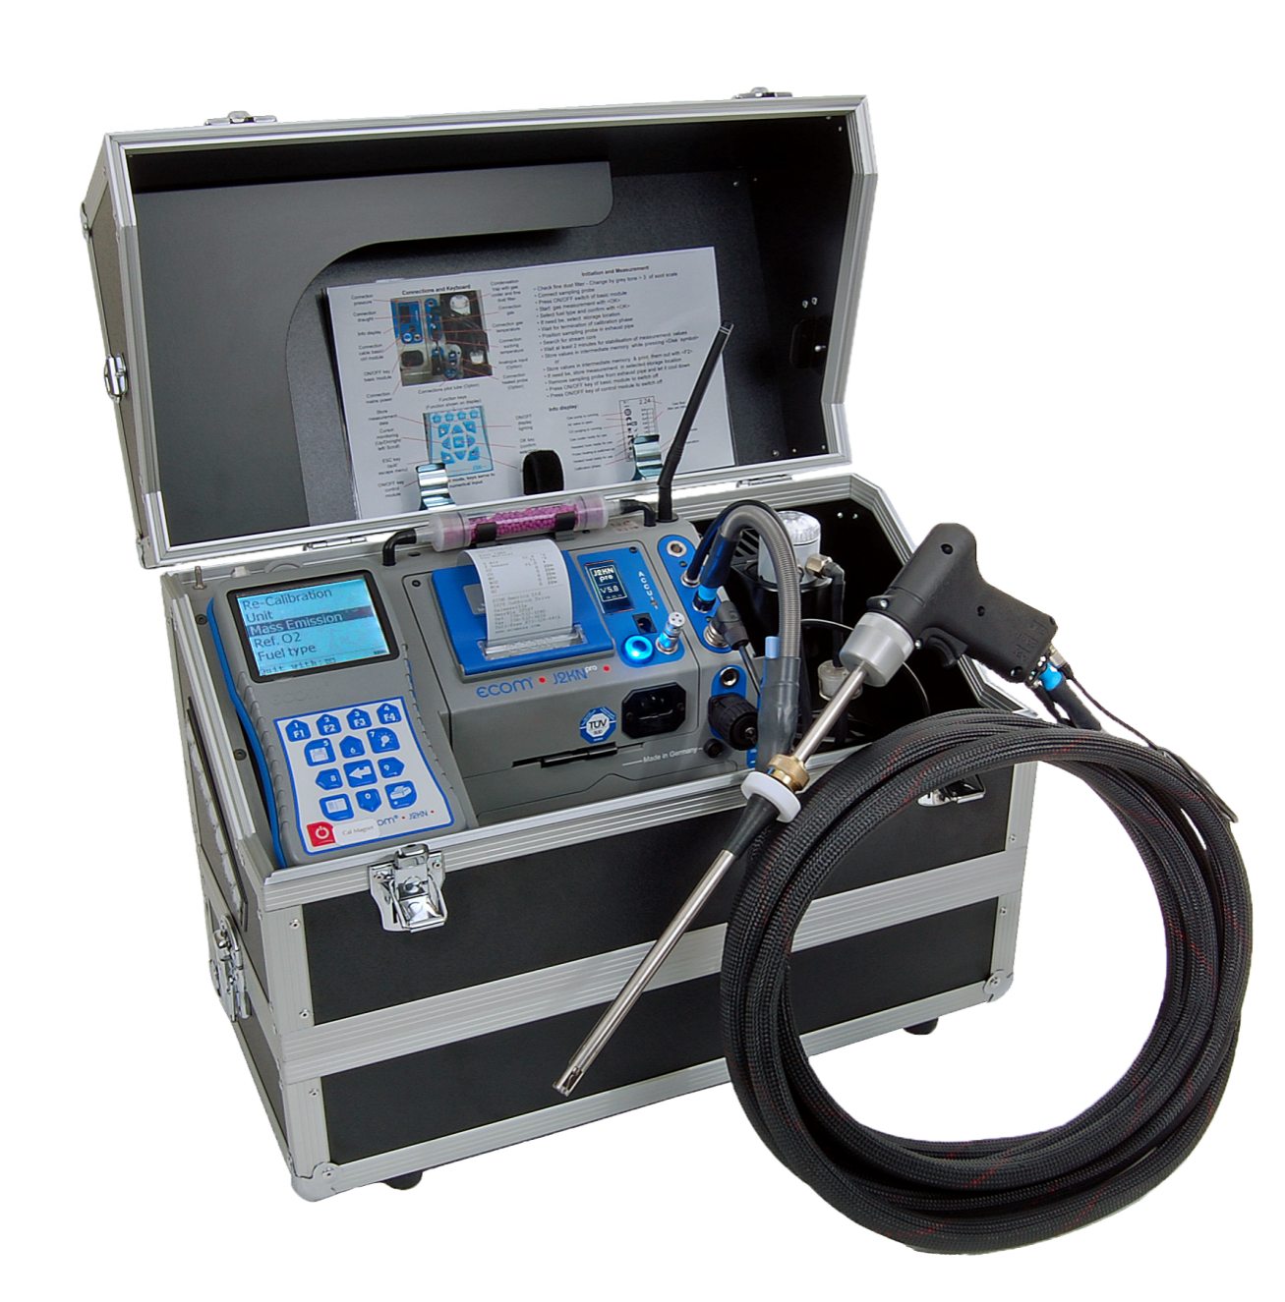
ECOM J2KN pro
Up to 6 gas sensors O2, CO, NO, NO2, SO2, Combustibles, and an NDIR bench
Remote Display
Thermoelectric Gas Cooler
High Flow Pump (2.0+ lpm)
On-board Printer
Auto-Drain Water Trap
Flow meter
6-8 hour battery life
On board data storage
Advanced DAS Compliance Testing Software
Pictured above: J2KN Pro Industrial with Teflon sample line and undercase

Slide 9
Analyzer Workshop / Walk through

Slide 10
Basic Emission Testing Procedure
1. Start the analyzer in fresh air.
2. Allow analyzer to run for 15-30 minutes to reach stable temperature.
3. Turn analyzer off and re-power. The analyzer will set accurate zero reference points & temperature compensation curves for the current temperature.
4. Insert probe into gas stream and observe the readings on the
display.
5. Upon completion of sampling, pull sample line out and allow analyzer to purge with fresh air until O2 readings are above 20.0% and other readings are below 15 ppm before powering off.

Slide 11
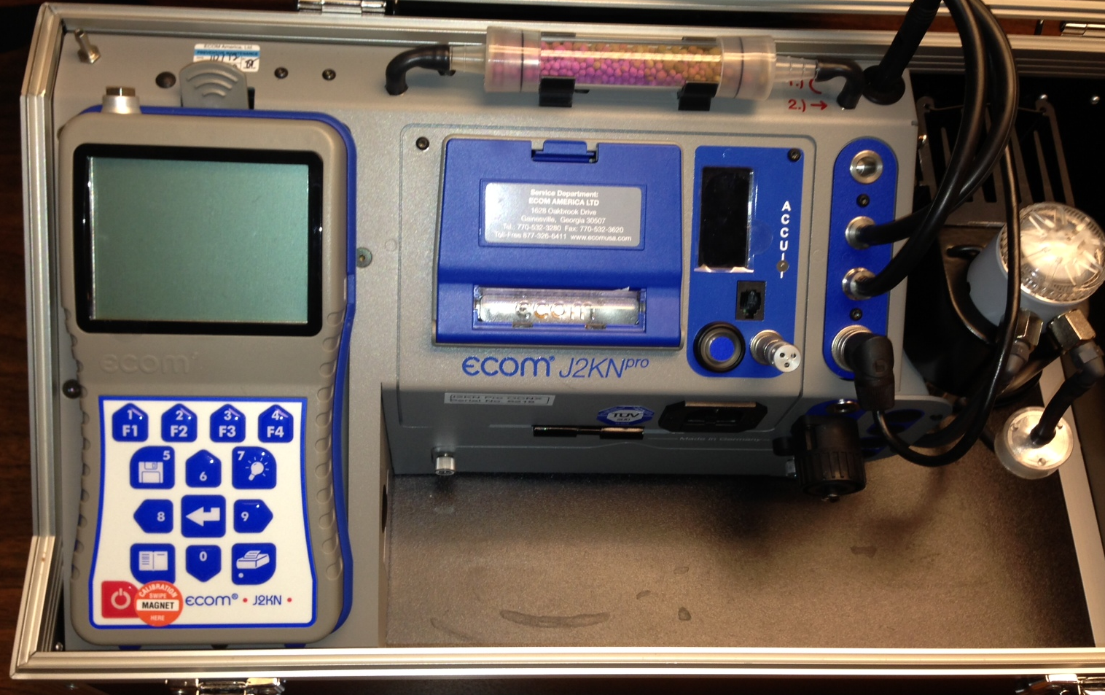
Power On (I/O switches)
Analyzer start-up

Slide 12
Keypad

Slide 13
Main menu
After powering on the base and handheld, the main menu will appear.
Press up/down to highlight the line you need, then press Enter (center button) to select that line.
The bottom of this screen shows 3 signal indicators:
-display contrast (see next slide)
-RF signal of the remote-to-base connection
-handheld battery strength

Slide 14
Contrast control
While in the main menu, the buttons F1 and F2 are used for contrast control of the LCD display.
F1 = lighten contrast
F2 = darken contrast

Slide 15
Gas analysis - choose fuel type
Once you enter Gas Analysis, the pump will turn on.
First you must select your fuel. Press up/down to scroll between the fuel type selections.
The Fuel Type selection only affects the CO2, Efficiency, and Losses calculations NOT the ppm concentration of the emissions.

Slide 16
Gas analysis – 1-min auto zero
The 1-minute auto zero sequence does the following:
-Calibrates O2 sensor at 20.9%
-Sets zero points for all other sensors
-Sets temperature compensation curves for current temperature
-Checks mV reading of all sensors i.e. “function test”
Note: If the ambient temperature drifts more than 10°F, it is recommended to restart the analyzer to set accurate temperature compensation.

Slide 17
Gas analysis
After the 1-minute auto-zero sequence, you will enter Gas Analysis mode.
There are 3 display screens:
Press up/down to toggle between 3 display screens
1: Zoom display (4 lines – large font size)
2: Full display (9 lines)
3: Full display (9 lines)
There are 4 icons at the bottom of the display:
F1: Standby (Pro Easy) or Purge (Pro Industrial)
F2: Quick print
F3: CO purge pump on/off
F4: Edit display lines
Note: At the bottom left of the display, you will see the number of the display screen you are currently viewing: 1, 2, or 3

Slide 18
Gas analysis – zoom display

Slide 19
Gas analysis – full display (2x)

Slide 20
CO purge pump
An automatic CO purge pump introduces fresh air into the CO sensor when CO concentrations exceed pre-set limits of the sensor (usually 4000ppm).
This protects the CO sensor from over-range damage.
The analyzer will monitor the CO level and turn the pump off when levels drop below the maximum range of the sensors.
Pressing F3 while in Gas Analysis mode activates the CO purge pump manually. The CO will dash out on the screen. Press F3 again to turn off the purge pump.

Slide 21
PRINTing your results
Quick print (recommended): To make a print-out of the current measurements, press the F2 key located below the printer icon displayed in the lower left portion of the LCD.
The printer will start and the LCD will indicate the status of the print job.
If you press the button with the printer icon, you must first press the button with the disk icon (#5) to save into temporary memory, then press the printer button.

Slide 22
Adjustments
Adjustments allows the user to make changes to calculated and measured values, such as:
Units (ppm, mg/m3)
O2 Correction
Time / Date Set
Bluetooth/USB baud rates
Change info on bottom of print-out

Slide 23
Units of Measure
Units of measure can be
selected for :
PPM
PPM – O2 Corrected
Mg/m3
Mg/m3 – O2 corrected
Mg/kWh – O2 corrected
Mg/MJ – O2 corrected

Slide 24
General Care & Maintenance

Slide 25
filters
The J2KN Pro has 3 filters which should be periodically changed:
Particulate filter (top of water trap)
In-line smoke filter (tubing leading out of water trap)
NOx/Sox filter (purple beads in tube on top of analyzer)

Slide 26
filters
NOx/SOx filter
Particulate filter
In-line smoke filter

Slide 27
Filters – particulate filter & in-line smoke filter
Particulate filter
First line of defense
Filters out particulates and NH3
Change when it turns dark gray
In-line smoke filter
Second line of defense
Filters out microparticulates & smoke
Change when it turns dark gray

Slide 28
Filter - NOX / Sox Filter Media
This filter is in-line of the CO sensor only!
The analyzer uses a potassium permanganate filter media to remove acid gases from the gas stream prior to introduction to the CO sensor, thus protecting the sensor from cross-interference and damage to the electrochemical solution.
DO NOT USE DESSICANT. Use only filter media supplied by ECOM America.
The filter media will change color based on exposure to NOx and SOx gases:
purple -> brown -> gray -> white
Change the filter media when gray!

Slide 29
Batteries
Battery condition of the analyzer and remote can be checked in the Control mode.
Batt = remote (3 AA rechargeable)
Batt B = base unit (lead-acid)
Batteries in the remote will recharge when in the cradle and the main battery will recharge when connected to AC power.

Slide 30
Storing the analyzer
Keep the battery fully charged and operate the analyzer on AC main voltage when possible.
Fully charge the battery prior to storage or leave connected to main power if possible. Full charge takes 8-10 hours.
Store the analyzer in a cool, dry place while plugged into AC power. If it is not possible to keep the analyzer plugged in while stored, make sure to charge it overnight at least once/month.

Slide 31
calibration
For detailed calibration instructions, consult the J2KN Pro Operations Manual.

Slide 32
Calibration gas
Rich burn
CO gas balanced in air
NO gas balanced in N2
NO2 gas balanced in air
Lean burn
CO/NO gas balanced in N2
NO2 gas balanced in air

Slide 33
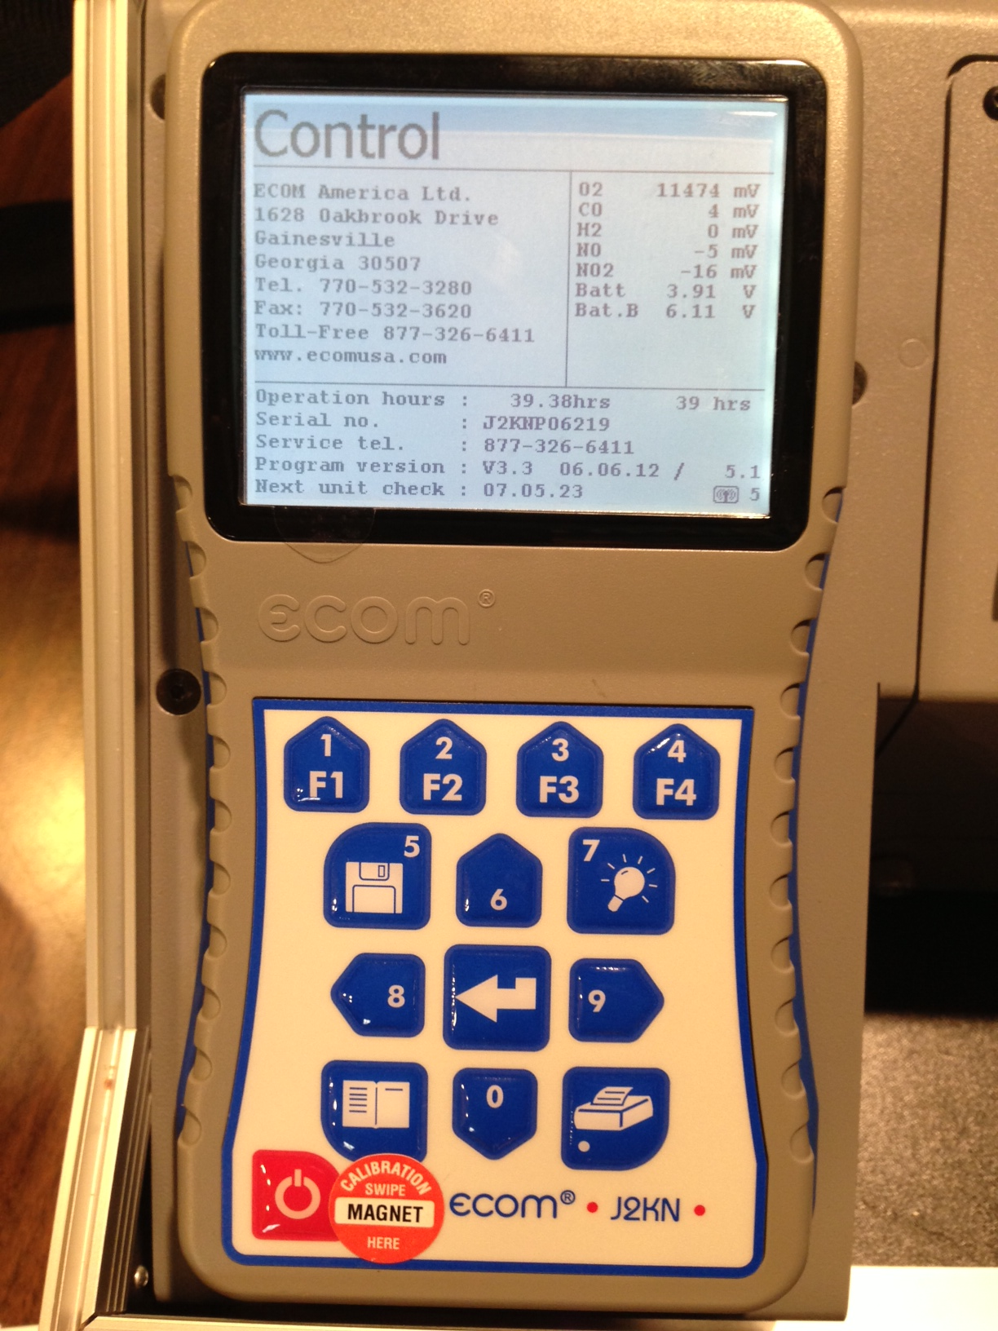
Calibration Mode
To enter calibration mode, the remote unit must be in the base cradle.
Select CONTROL on main menu, then OK .
Swipe calibration magnet over the area to the right of the on/off button on the remote.

Slide 34
Calibration Mode
After swiping the cal magnet, the analyzer will enter calibration mode.
Press up/down to position the cursor beside the sensor you are calibrating.

Slide 35
Basic Emission Testing Procedure
1. Start the analyzer in fresh air.
2. Allow analyzer to run for 15-30 minutes to reach stable temperature.
3. Turn analyzer off and re-power. The analyzer will set accurate zero reference points & temperature compensation curves for the current temperature.
4. Insert probe into gas stream and observe the readings on the
display.
5. Upon completion of sampling, pull sample line out and allow analyzer to purge with fresh air until O2 readings are above 20.0% and other readings are below 15 ppm before powering off.

Slide 36
Thank you
1628 Oakbrook Drive
Gainesville, GA 30507
Toll Free: 877.326.6411
Telephone: 770.532.3280
Fax: 770.532.3620
www.ecomusa.com

