Slide 1
Ecom America
EN2F Emissions Analyzer

Slide 2
ECOM America Ltd.
Established in USA in 1993
20th anniversary
Sister company of RBR-ECOM, located in Iserlohn, Germany, established in 1985
Manufacturer of high quality portable combustion / emission analyzers

Slide 3
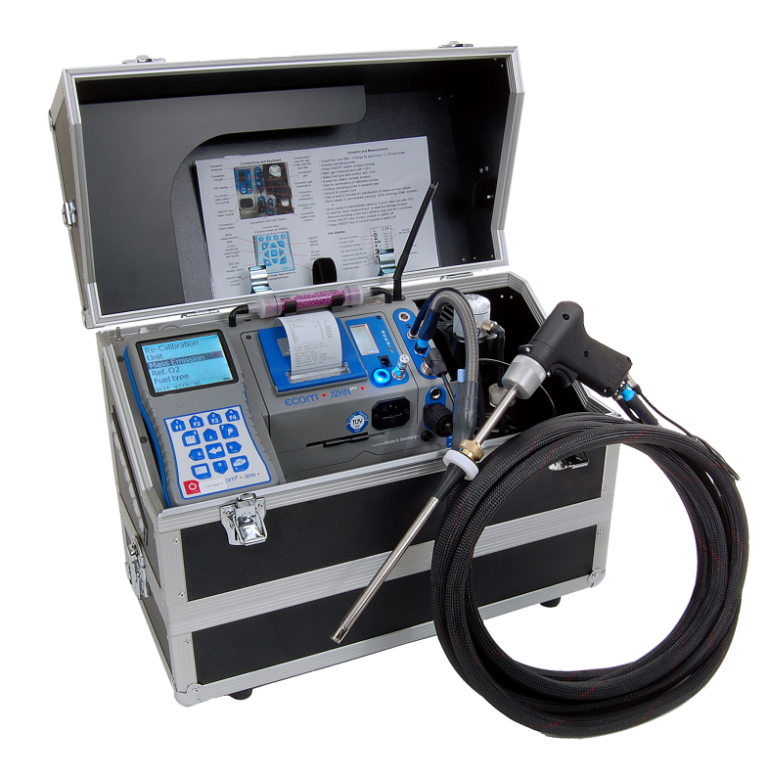
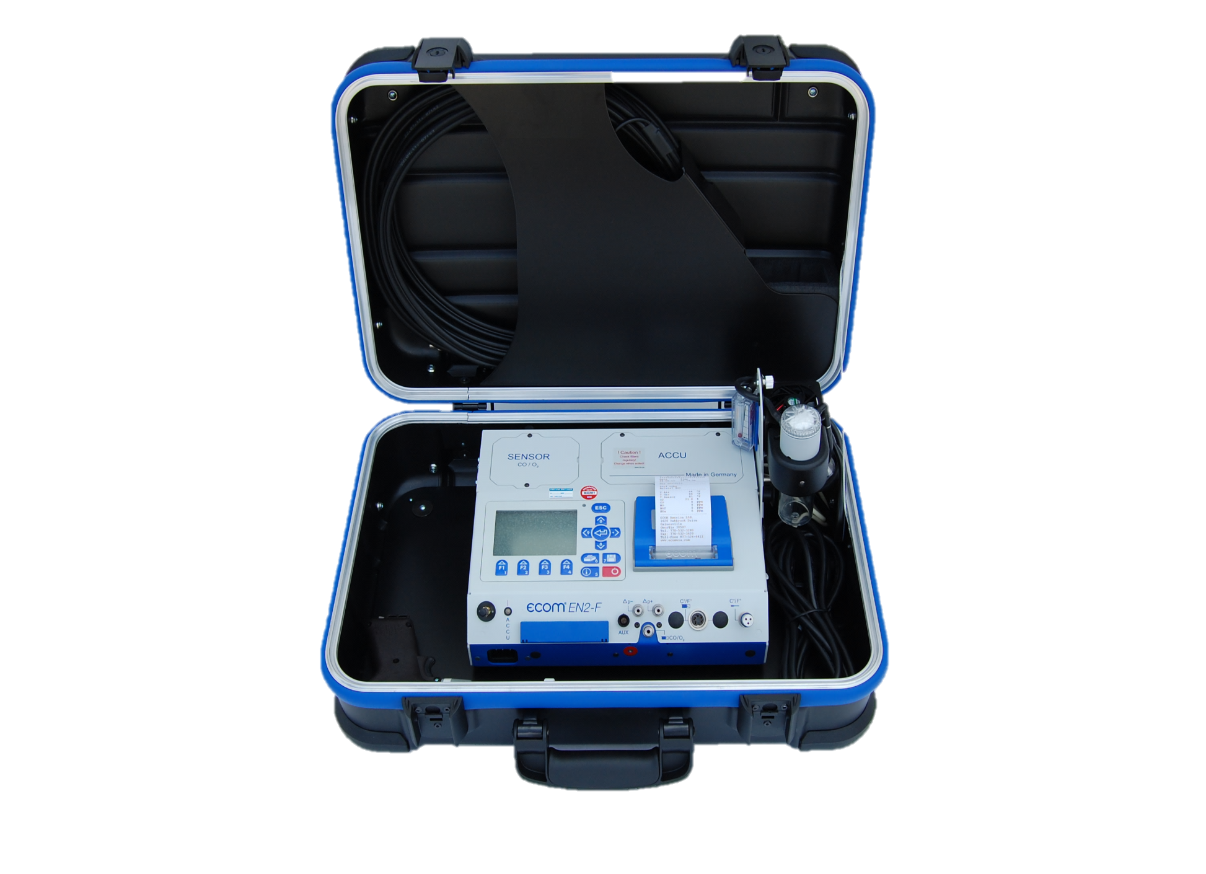
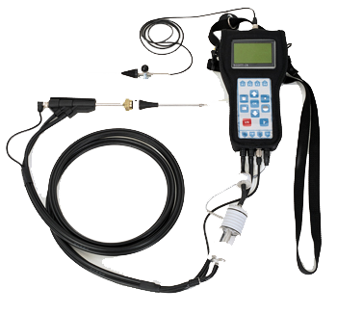
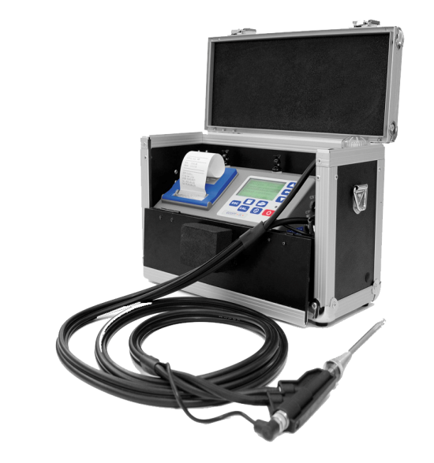
ECOM Products
CN
CL
EN2F
J2KN PRO

Slide 4
Peltier cooler connected to a peristaltic pump: -Efficient gas cooling -Automatic water removal
The Advantages of Ecom
Notes:
We explain to our customers the importance of proper gas cooling and ,moisture removal. And also show them how it works.

Slide 5
ECOM vs. Competition
Portable analyzers is all we do
Rugged packaging, robust analyzer
High strength internal pump = fast response time, consistency of results
ECOM analyzers are known for having advanced sample conditioning features
1-2 week turn-around when you send in your analyzer in for service

Slide 6
ECOM vs. Competition
Inadequate Sample Conditioning – gas coolers are generally too small to effectively cool the gas and remove the moisture.
Pump Flow Rate too low – ECOM uses a 2–3 liter per minute flow. Competitors use 0.5-1.5 liter per minute. This means:
Slow response time
Slow stabilization
Limits the use of a longer sample line
Allows gas to be in contact with moisture for longer period of time
NO2 drop-out leads to lower NOx accuracy

Slide 7
ECOM EN2F
Up to 4 gas sensors O2, CO, NO, NO2 (True Nox)
Remote Display (optional)
Thermoelectric Gas Cooler
High Flow Pump (1.8+ lpm)
On-board Printer
Auto-Drain Water Trap
Flow meter
6-8 hour battery life
On board data storage
– memory card slot
Bluetooth or WiFi

Slide 8
Basic Emission Testing Procedure
1. Start the analyzer in fresh air.
2. Allow analyzer to run for 15-30 minutes to reach stable temperature.
3. Turn analyzer off and re-power. The analyzer will set accurate zero reference points & temperature compensation curves for the current temperature.
4. Insert probe into gas stream and observe the readings on the
display.
5. Upon completion of sampling, pull sample line out and allow analyzer to purge with fresh air until O2 readings are above 20.0% and other readings are below 15 ppm before powering off.

Slide 9
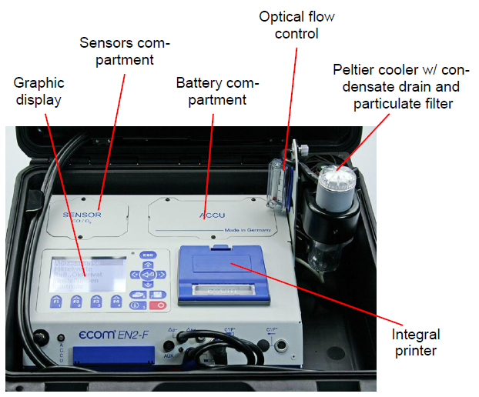
Analyzer design

Slide 10
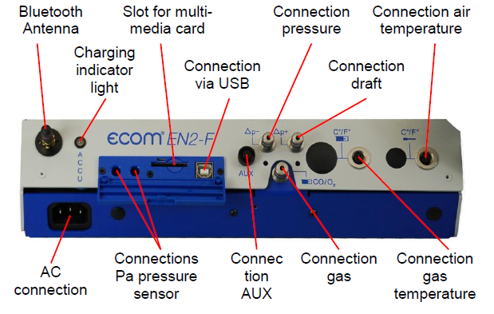
connections

Slide 11
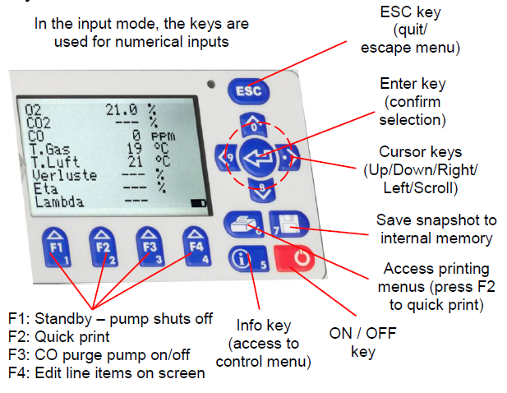
KEYPAD

Slide 12
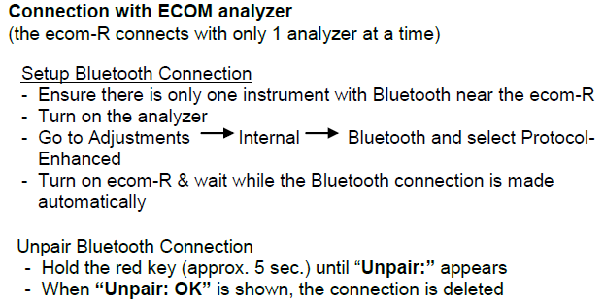
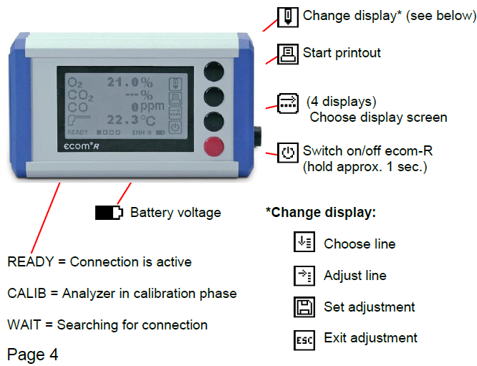
Bluetooth remote (option)

Slide 13
DATA COLLECTION OPTIONS
Use printer for paper print-outs (averaging or snapshots)
On-board memory card slot saves data into a .csv file
Use WiFi to connect to mobile app and save a snapshot
Use WiFi and/or USB to communicate to DAS 5.1 software
Creates basic data reports
Advanced CRS software allows you to set-up procedures and customize data reports

Slide 14
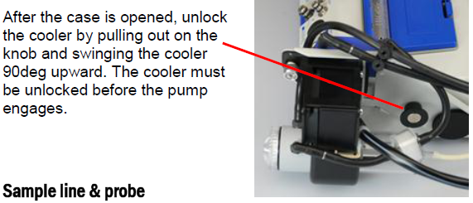
ANALYZER START-UP

Slide 15
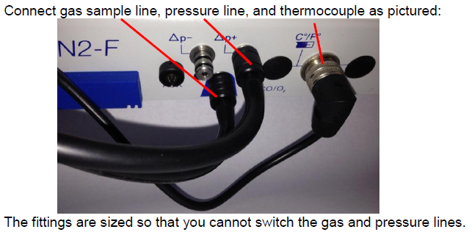
Analyzer start-up (continued)

Slide 16
Gas analysis - choose fuel type
Once you enter Gas Analysis, the pump will turn on.
First you must select your fuel. Press up/down to scroll between the fuel type selections.
The Fuel Type selection only affects the CO2, Efficiency, and Losses calculations NOT the ppm concentration of the emissions.

Slide 17
Gas analysis – 1-min auto zero
The 1-minute auto zero sequence does the following:
-Calibrates O2 sensor at 20.9%
-Sets zero points for all other sensors
-Sets temperature compensation curves for current temperature
-Checks mV reading of all sensors i.e. “function test”
Note: If the ambient temperature drifts more than 10°F, it is recommended to restart the analyzer to set accurate temperature compensation.

Slide 18
Gas analysis
After the 1-minute auto-zero sequence, you will enter Gas Analysis mode.
There are 4 display screens:
Press up/down to toggle between 4 display screens
1: Zoom display (4 lines – large font size)
2: Zoom display (4 lines – large font size)
3: Full display (9 lines)
4: Draft/Pressure measurement (pump will turn off)
There are 4 icons at the bottom of the display:
F1: Standby
F2: Quick print
F3: CO purge pump on/off
F4: Edit display lines

Slide 19
CO purge pump
An automatic CO purge pump introduces fresh air into the CO sensor when CO concentrations exceed pre-set limits of the sensor (usually 4000ppm).
This protects the CO sensor from over-range damage.
Pressing F3 while in Gas Analysis mode activates the CO purge pump manually. The CO will dash out on the screen. Press F3 again to turn off the purge pump.

Slide 20
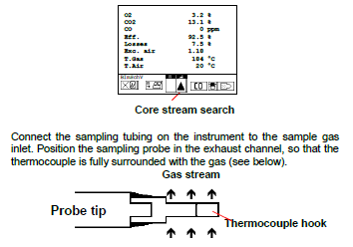
Inserting the probe
Ensure that the probe tip is in the center of the exhaust gas flow
Use the temperature indicator to find the ‘core stream’
The temperature will be the hottest in the core stream
Watch the indicator change from up arrow to down arrow – that is the point of maximum temperature, AKA the core stream
MKW

Slide 21
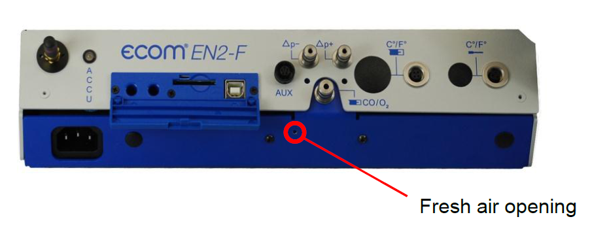
Co purge pump
An automatic CO purge pump introduces fresh air into the CO sensor when CO concentrations exceed pre-set limits of the sensor (usually 4000ppm).
This protects the CO sensor from over-range damage.
The analyzer will monitor the CO level and turn the pump off when levels drop below the maximum range of the sensors.

Slide 22
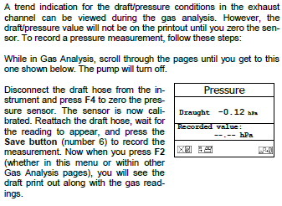
Draft/pressure measurement

Slide 23
PRINTing your results
Quick print (recommended): To make a print-out of the current measurements, press the F2 key located below the printer icon displayed in the lower left portion of the Gas Analysis display screen.
The printer will start and the display will indicate the status of the print job.
Print from memory: If you press the button with the printer icon, you must first press the button with the disk icon (#7) to save into temporary memory, then press the printer button. Remember to press #7 again to clear temporary memory before printing another snapshot.

Slide 24
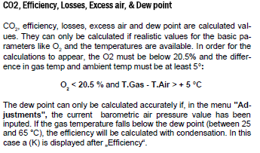
calculations
The calculations will only display and print out if they are valid.

Slide 25
Adjustments
Adjustments allows the user to make changes to calculated and measured values, such as:
Units (ppm, mg/m3)
O2 Correction
Time / Date Set
Bluetooth/USB baud rates
Change info on bottom of print-out

Slide 26
Units of Measure
Units of measure can be
selected for :
PPM
PPM – O2 Corrected
Mg/m3
Mg/m3 – O2 corrected
Mg/kWh – O2 corrected
Mg/MJ – O2 corrected

Slide 27
General Care & Maintenance

Slide 28
filters
The EN2F has 2 filters which should be periodically changed:
Particulate filter (top of water trap)
In-line smoke filter (tubing leading out of water trap)

Slide 29
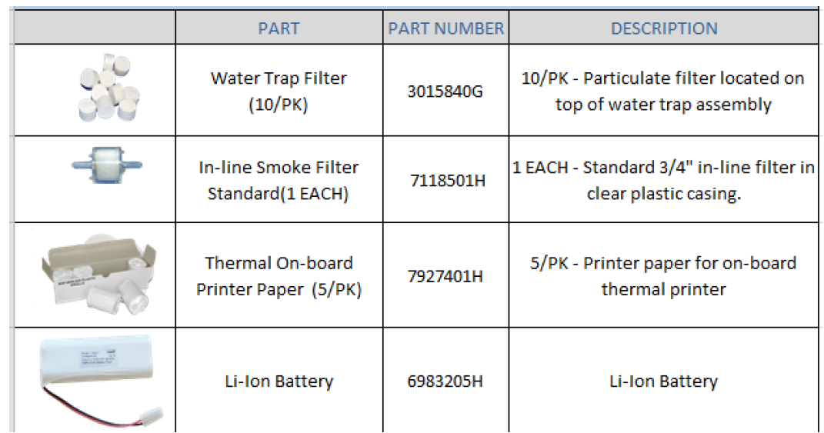
Accessories

Slide 30
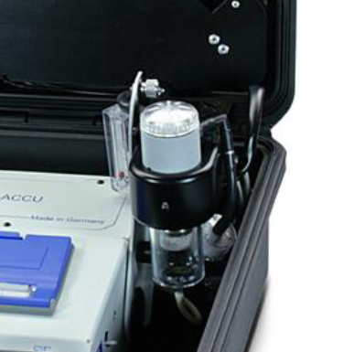
filters
The EN2F has 2 filters which should be periodically changed:
Particulate filter
First line of defense
Filters out particulates and NH3
Change when it turns dark gray
In-line smoke filter
Second line of defense
Filters out microparticulates & smoke
Change when it turns dark gray

Slide 31
Batteries
The Li-Ion battery will last 6-8 hours when fully charged.
Battery condition of the analyzer and remote can be checked in the Control mode.
5.7V to 6.7V is good
Battery alarm will start after it drops below approx. 5.7V.
(If you are using the Bluetooth remote, the display will automatically go dark after a period of time to save the battery life.)

Slide 32
Storing the analyzer
Keep the battery fully charged and operate the analyzer on AC main voltage when possible.
Fully charge the battery prior to storage or leave connected to main power if possible. Full charge takes 8-10 hours.
Store the analyzer in a cool, dry place while plugged into AC power. If it is not possible to keep the analyzer plugged in while stored, make sure to charge it overnight at least once/month.

Slide 33
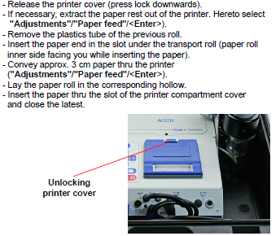
Changing printer paper

Slide 34
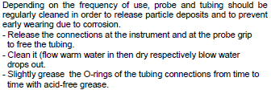
Probe and sample line cleaning

Slide 35
Calibration Mode
To enter calibration mode, select CONTROL on main menu, then OK .
Swipe calibration magnet over the area up-left of the ESC button.
After swiping the cal magnet, the analyzer will enter calibration mode.
Press up/down to position the cursor beside the sensor you are calibrating.

Slide 36
Basic Emission Testing Procedure
1. Start the analyzer in fresh air.
2. Allow analyzer to run for 15-30 minutes to reach stable temperature.
3. Turn analyzer off and re-power. The analyzer will set accurate zero reference points & temperature compensation curves for the current temperature.
4. Insert probe into gas stream and observe the readings on the
display.
5. Upon completion of sampling, pull sample line out and allow analyzer to purge with fresh air until O2 readings are above 20.0% and other readings are below 15 ppm before powering off.

Slide 37
Thank you
1628 Oakbrook Drive
Gainesville, GA 30507
Toll Free: 877.326.6411
Telephone: 770.532.3280
Fax: 770.532.3620
www.ecomusa.com

